Slide 1
Setup a new measuring instance

Slide 2
Bill of Material
Pi 5 with at least 4GB RAM
NVME Extension and minimum 128GB SSD
abaton clima measurement system PCB [short: ACMS]
Network Cable RJ45
Digisense
Mux PCB
2 x Scale Duett 8kg
9V PSU
6 x ENS 210
4 x DS18B20 (PT1000)
2 x Hailege MLC90614 IR Cam
Webcam with USB
2 x flow measurement unit

Slide 3
Setting up the new pi
take a new pi and generate an image for a pi5 with some settings:
username: rabaton
password: lack..
wifi: rudi // bbaton125!
enable ssh
first time boot use an external monitor and obtain the IP address of the device
enable under preferences -> raspberry configuration
onewire
I2C
SPI
then reboot. afterwards -> Accessoires -> SD Card Copier
copy content of SD card onto SSD (new UUID Partitions must be checked)
open sudo nano /boot/firmware/config.txt and add the line: dtparam=pciex1
power off, remove SD card, power on
register the pi with our raspberry cloud:
sudo apt update
sudo apt upgrade
click icon right top on the desktop with the two squares and the circles and use
beschaffung@abaton.studio
rasART135!
ssh key für ds_readout git raphael geben
ssh-keygen -t rsa
den public key ins gitHub kopieren als deploy key
git clone https://github.com/xtlc/ds_readout.git machen am pi
cd ds_readout
python -m venv venv
source venv/bin/activate
python -m pip install -r req
Create an empty env file nano .env, save with CRTL + O and [y]
echo 'export GIT_MERGE_AUTOEDIT=no' >> $HOME/.bash_profile && . $HOME/.bash_profile #make sure the git pull does not open an editor

Slide 4
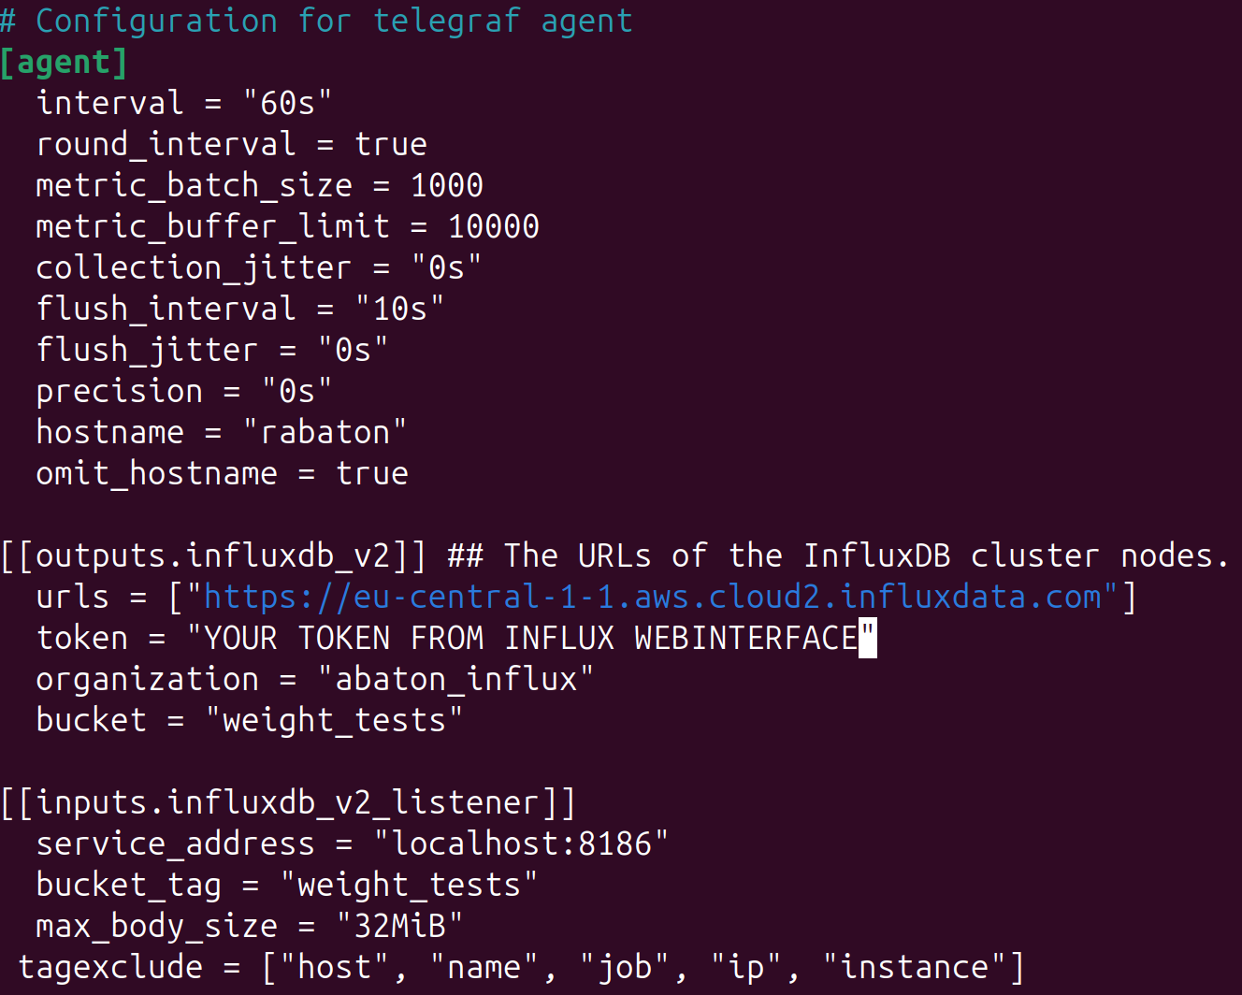
Setting up telegraf
Telegraf is a service that makes sure, when data should be stored at influx but the internet connection is disrupted, that the data is stored locally and sent once internet is available again.
Install guide: Link and quick start: Link
SSH into the raspberry or access locally:
wget -q https://repos.influxdata.com/influxdata-archive_compat.key
echo '393e8779c89ac8d958f81f942f9ad7fb82a25e133faddaf92e15b16e6ac9ce4c influxdata-archive_compat.key' | sha256sum -c cat influxdata-archive_compat.key | gpg --dearmor | sudo tee /etc/apt/trusted.gpg.d/influxdata-archive_compat.gpg > /dev/null
echo 'deb [signed-by=/etc/apt/trusted.gpg.d/influxdata-archive_compat.gpg] https://repos.influxdata.com/debian stable main' | sudo tee /etc/apt/sources.list.d/influxdata.list
sudo apt-get update && sudo apt-get install telegraf
sudo nano /etc/telegraf/tg.conf
Load config & start telegraf with: telegraf --config /etc/telegraf/tg.conf &

Slide 5
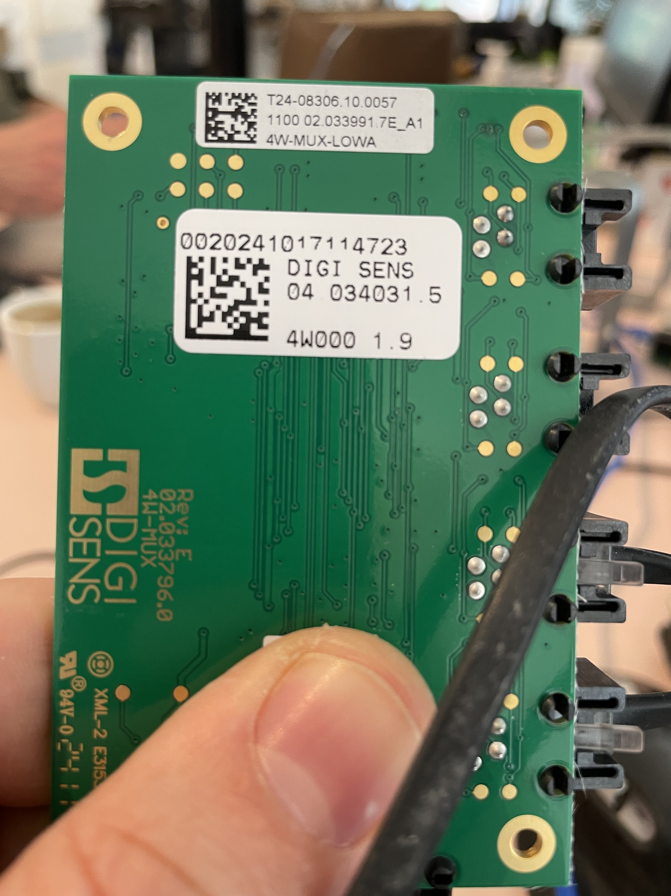
Setting up the scales
Connect MUX to ACMS using a RJ45 cable
Plug 9V power supply into ACMS
Take Sticker from MUX plate and use number
write number into the .env file:
MUX=0020241017114723 (in this case)

